Slide 1
Microstructure of Steel

Slide 2
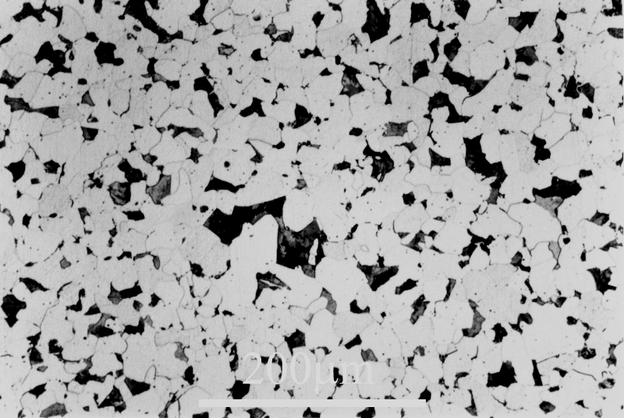
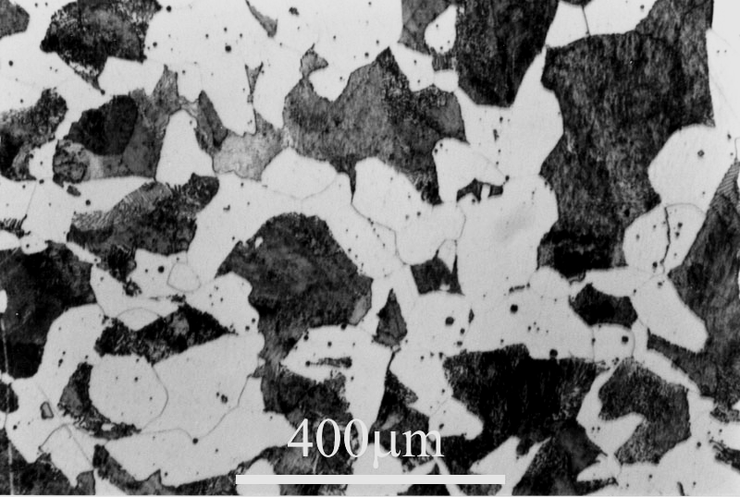
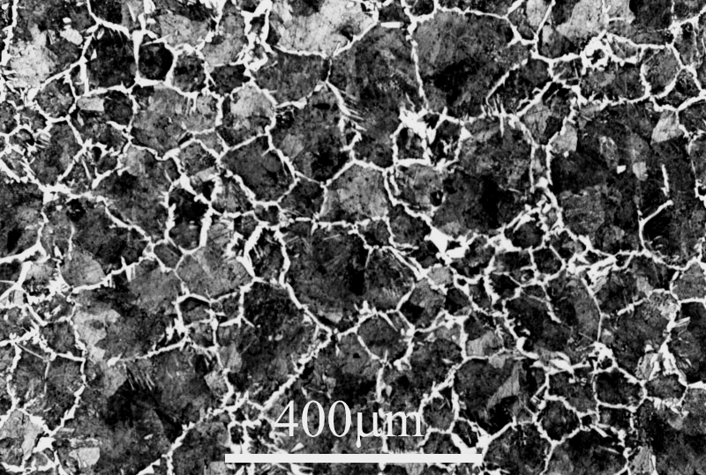
Different carbon contents

Slide 3
Eutectoid microstructure

Slide 4
Influence of Cooling Rate

Slide 6
Mechanical Properties of Steels mainly depend upon:
1. Carbon Content
(+ other Alloying elements)
2. Cooling rate

Slide 7
Effect of cooling rate

Slide 8
Annealing 1. Heat to austenite region 2. Soak for a suitable time depending upon size of component 3. Cool to room temperature in furnace
Hardening
1. Heat to austenite region 2. Soak for a suitable time depending upon size of component 3. Cool to room temperature by quenching into oil or water
Normalizing 1. Heat to austenite region 2. Soak for a suitable time depending upon size of component 3. Cool to room temperature in air

Slide 9
Annealing
1. Heat to austenite region
2. Soak for a suitable time depending upon size of component
3. Cool to room temperature in furnace

Slide 10
Normalizing
1. Heat to austenite region
2. Soak for a suitable time depending upon size of component
3. Cool to room temperature in air

Slide 11
Hardening
1. Heat to austenite region
2. Soak for a suitable time depending upon size of component
3. Cool to room temperature by quenching into oil or water

Slide 12
Tempering
Tempering is carried out at a temperature below the sub-critical temperature in order to reduce ‘brittleness’
However, Hardness also suffers a loss as a consequence. Hence a compromise has to be opted for an optimum combination of hardness and toughness

Slide 13
Martensite

Slide 15
Microstructure of high-speed tool steel

Slide 16
T. T. T. Diagram

Slide 17
T. T. T. Diagram

Slide 18
Case Hardening

